Slide 1
VI Conference Payments and securities settlement systems
National bank of Macedonia Ohrid, 07.2013
KIBS AD Skopje M. Sc. Paunkoski Nikola

Slide 2
Harmonization with SEPA in Republic of Macedonia

Slide 3
Introduction

Slide 4
The new roles in SEPA Regulations
The EPC (not-for-profit organization ) developed the SEPA payment schemes and frameworks, based on global technical standards made available by international standardization bodies, in close dialogue with the customer community.

Slide 5
The SEPA Council
The SEPA Council, which brings together representatives of both the demand and supply sides of the payments market including the EPC, EACHA, was established by the European Commission and the ECB in June 2010.
Its aim is to promote the realization of an integrated euro retail payments market by ensuring proper stakeholder involvement at a high level and by fostering consensus on the next steps towards the full realization of SEPA.
The SEPA Council does not replace any existing groups or structures at national or European level.

Slide 6
SEPA the end of the beginning
End date is not an option but mandatory by low
Euro countries in SEPA need to phase out the national credit transfer and direct debit payment instruments by 1 February 2014
Banks, public authorities and corporates need to migrate to SEPA SCT and SDD

Slide 7
SEPA the end of the beginning
Set of documents available
Tools to test
Dedicated customer support
SEPA migration managers in place

Slide 8
Migrated opinion on SEPA
Harmonized European legislation
1 account
Improved lifecycle on the value dates
Efficient communication
1 format
1 cannel
Cross-border product

Slide 9
EACHA
European association of automated clearing houses
Ready themselves for cross-border processing
Joined forces in forum for cooperation
Interoperability
Interbank clearing systems have to
Be compliant with the SEPA schemes
Establish technical links to provide interoperability
National CSM to became SEPA compliant
Local partners ensuring smooth SEPA migration

Slide 10
EACHA
European association of automated clearing houses

Slide 11
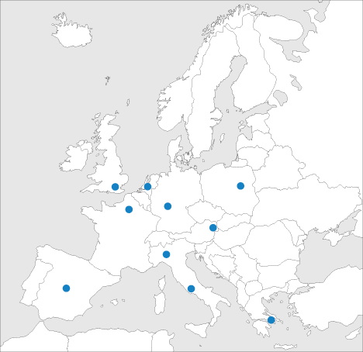
EACHA
EACHA Interoperability
Framework 5.0
Processing of SEPA Payments

Slide 12
Non euro countries
Preparing to switchover from national to SEPA payment instruments 31.10.2016.
Wait for end date
Prepare to ensure competitiveness for their economies

Slide 13
SEPA in Republic of Macedonia
National council for payment system of Republic of Macedonia
Ministry of finance
NBRM
Association of Banks
Clearing and settlement mechanisms
New strategy of developing of payment system – still looking forward to SEPA

Slide 14
SEPA in Republic of Macedonia
Implementing SEPA standards while
Introducing new payment instrument
Changing of existing one

Slide 15
Products
Clearing and settlement mechanisms
Credit transfer
Direct debit
Cards
Value added services
E – invoice, mandate …
New technologies
Mobile, internet, fast payments
McDonald`s
Hamburger
Cheeseburger
Toast
Fries, Coca Cola,
McDrive, salads …

Slide 16
CSM
Could it be paid without bank account and payment order?
Could one bank provide alone infrastructure for their costumers?
Cooperation in the non-competitive space
Do what you best know Clearing and settlement
Keep close to requirements Licenses
Use standards Open access infrastructure
Legal clarity and certainty Banks, Accounts
Manage risks Integrity and customer trust
Answer to challenges Speed, canals, technology, market demand
Business case for providers Benefits for consumers

Slide 17
SEPA in Republic of Macedonia
Harmonization with EU & SEPA in Republic of Macedonia could start with
SEPA like DIRECT DEBIT – national scheme

Slide 18
Regulation
Payment low – few changes
National rulebook for domestic Direct Debit
Specifics and Differences
SEPA Rulebook - Standards and Formats
Guideline for payment instruments
Upgrade

Slide 19
Direct debit
The SDD Core Scheme allows a biller to collect funds from a payer’s account provided that a signed mandate has been granted by the payer to the biller

Slide 20
Direct Debit project
Set of documents available
Tools to test
Dedicated customer support
SEPA migration managers in place

Slide 21
Direct debit Simulator
Debtor- overview on Mandate

Slide 22
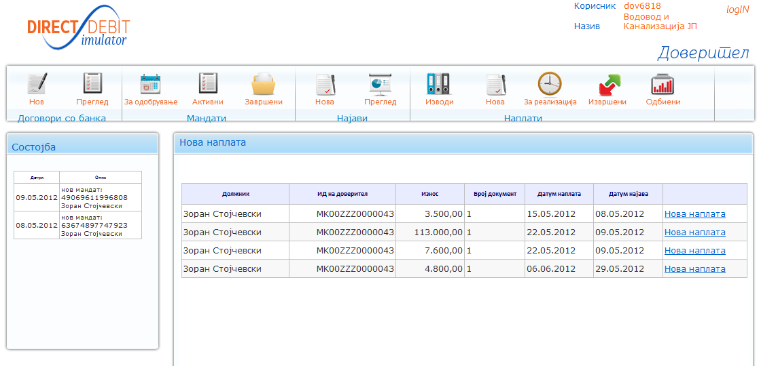
Direct debit Simulator
Creditor- overview on Pre-notification and Collections

Slide 23
SDD Simulator
Users:
Web access to SDD Simulator
https://ddsimulator.kibs.mk/

Slide 24
SDD Simulator what next
Strong support from NBRM
New Strategy for development of payment system in Republic of Macedonia – NSPS
Preparing for testing of actors solutions for SDD
Coordination with public and governmental bodies
Processing of regulation changes

Slide 25
Hurry up,
there is no end date
but business case
Thank you
M. Sc. Nikola Paunkoski
tel. 02 3297451
nikolap@kibs.com.mk

Slide 26
Questions

